Slide 1
Graded Quiz Question #1
Which macromolecule has the highest Atwater factor
Carbohydrate
Protein
Fat
They are all the same

Slide 2
Graded Quiz Question #2
Basal metabolic rate decreases with age primarily because of…
Increases in fat mass
Reductions in lean mass
Decreases in physical activity
Increased thermic effect of food

Slide 3
Graded Quiz Question #3

Slide 4
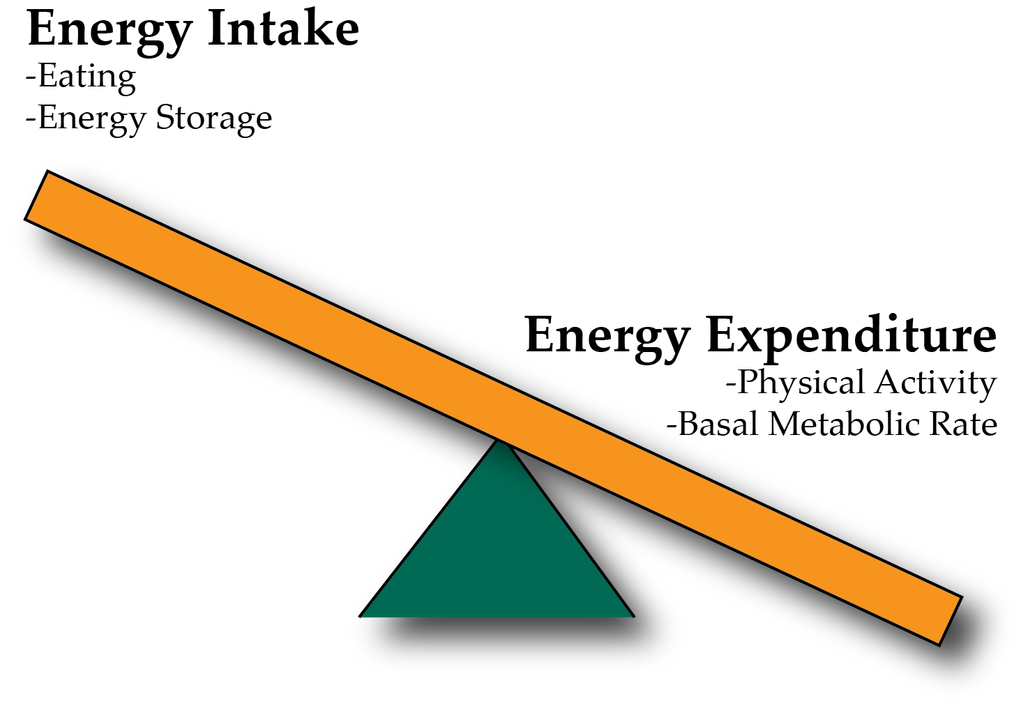
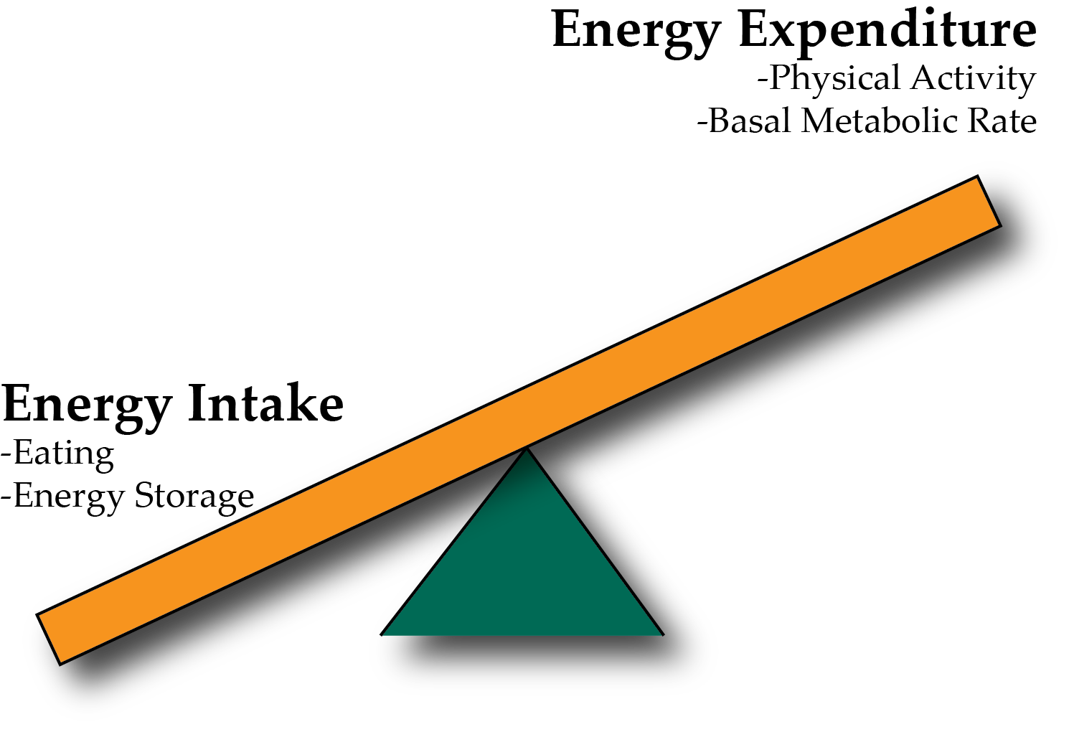
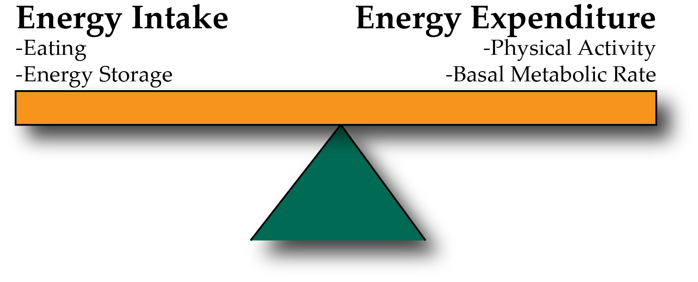
Energy Balance and Obesity
Positive Energy Balance – Weight Gain
Negative Energy Balance – Weight Loss
Notes:
Be here at 9:20

Slide 5
Concept Map
Energy Intake
Energy Expenditure
Energy Ingested
Energy Excretion
Atwater Factor
Basal Metabolic Rate
Thermic Effect of Food
Exercise Activity Thermogenesis
Energy Balance
Weight Gain
Weight Loss
FFQ
Diet Recalls
Fecal Energy Content
Gut Nutrient Sensing
Calories in Food

Slide 6
Assessing Energy Intake
Several methods of assessing energy intake
Observational
Diet Recall Surveys
Food Frequency Questionnaires
More about diet recalls in an optional assignment

Slide 7
In terms of energy, is a gram of fat equivalent to a gram of protein?
Yes
No
It depends

Slide 8
In terms of energy, is a calorie of fat equivalent to a calorie of protein?
Yes
No
It depends

Slide 9
Why do we start and stop eating?
Why do we eat
Why do we stop eating
Drive for food
Low blood glucose
Stress
Stomach is full
Rise in gut-derived hormones
Rise in insulin and glucose
~20 minute lag between eating and feeling full

Slide 10
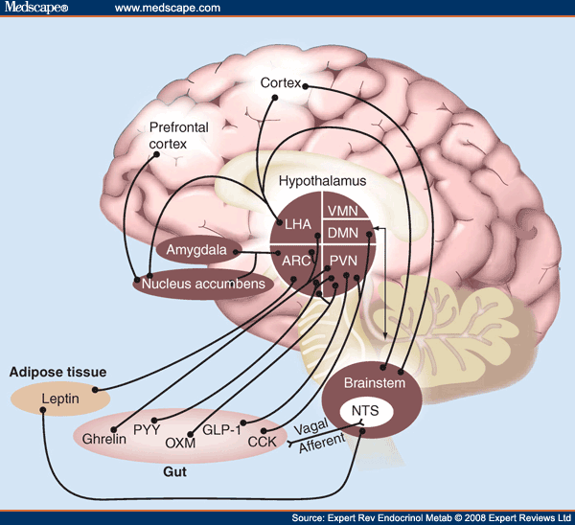
The Central Role of The Hypothalamus

Slide 11
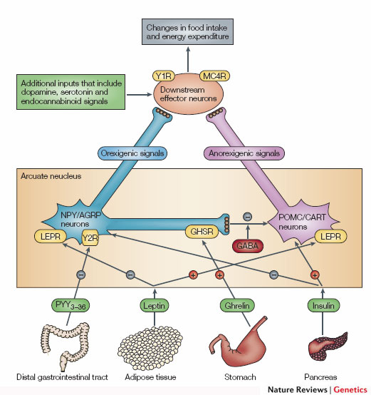
The POMC/AgRP Circuit
Promotes
Eating
Suppresses
Appetite
Notes:
Two populations of neurons in the arcuate nucleus.

Slide 12
Stress!!!
Cortisol (a glucocorticoid stress hormone) activates AGRP Neurons
This drives feeding behavior
Adrenaline (a short term stress hormone) may also drive appetite

Slide 13
Timed feeding cues
Cortisol awakening response
Sharp rise in cortisol shortly before waking up
May differ between chronotypes
48% genetic
How do you think this would affect feeding behaviors?
Kudielka BM, Federenko IS, Hellhammer DH, Wüst S. Morningness and eveningness: The free cortisol rise after awakening in “early birds” and “night owls.” Biol Psychol. 2006; 72: 141–6. doi: 10.1016/j.biopsycho.2005.08.003.

Slide 14
Why do we stop eating?
The role of our gastrointestinal system
Notes:
~20 minute lag between eating and feeling full

Slide 15
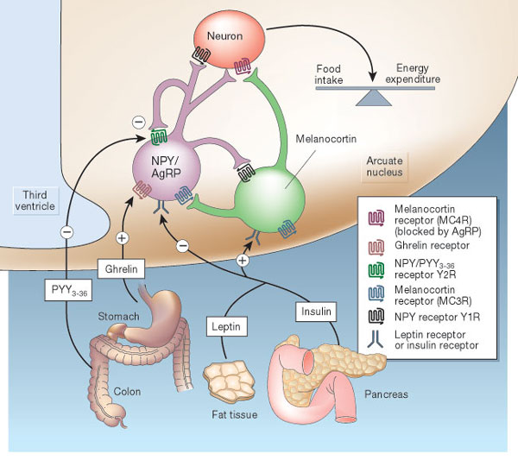
Hormonal Control of Appetite
Notes:
Think about it this way… AgRP neurons like to be on, and when they are on they increase appetite.

Slide 16
Metabolic Signals
Glucose
Signals both at POMC/AgRP and other hindbrain regions to reduce appetitive drive
Insulin
Signals directly at POMC/AgRP circuit to reduce appetitive drive
Proteins and Fats
Suppressive (FGF21/CCK)
Leptin
Related to adipose tissue size

Slide 17
Vagal Nerve Signaling
Notes:
Enteric nervous system
Second brain
500 million neurons

Slide 18
Gut Derived Appetite Hormones
Appetite Promoting
Ghrelin
Appetite Suppressing
GLP1
PYY
CCK

Slide 19
Summary of gut signals
Signal | Effect of food | Effect
Vagal stimulation | Stimulation | Inhibitory
GLP-1 | Secreted by small intestine | Inhibitory
PYY (Peptide YY) | Secreted by small intestine | Inhibitory
CCK | Secreted by small intestine | Inhibitory
Ghrelin | Stomach secretion stops with food | Activating

Slide 20
Endocrine Regulation of GI Function

Slide 21
Summary of Enteroendocrine Hormones
Hormone | Released from | Roles
Gastrin | Stomach and Small Intestine (Amino acids, stomach stretch) | Release acid into stomach, increase motility
Secretin | Small Intestine (Acid) | Release bicarbonate into small intestine
CCK (Cholecystokinin) | Small Intestine (Fatty acids and amino acids) | Bile Secretion, Pancreatic Enzyme Secretion, reduces motility
Motilin | Small Intestine | Increased motility
Parasympathetic Nervous System | Brain | Rest and digest, release of CCK
Sympathetic Nervous System | Brain | Fight or flight, pyloric sphincter

Slide 22
Energy Expenditure

Slide 23
Parts of the Metabolic Rate
Energy Expenditure Component | Increased by
Exercise Activity Thermogenesis (NEAT/EAT) | Exercise and movement
Thermic Effect of Food (TEF) | Protein in Meal, Insulin Sensitivity, Meal Size
Basal Metabolic Rate | Young Age, Sex (M), Lean Mass, Set Point
Maclean PS, Bergouignan A, Cornier M-A, Jackman MR. Biology’s response to dieting: the impetus for weight regain. Am. J. Physiol. Regul. Integr. Comp. Physiol. 2011;301(3):R581–R600. http://dx.doi.org/10.1152/ajpregu.00755.2010
Notes:
Impact of weight loss on the components of total energy expenditure (TEE). Energy-restricted weight loss impacts every component of energy expenditure. The absolute levels of resting energy expenditure (REE) decline from a loss of metabolic mass and enhanced metabolic efficiency. Nonresting energy expenditure (NREE) declines, unless the level of physical activity and its associated exercise activity thermogenesis (EAT) are substantially increased. This increase must overcome the decline in the TEF that results from lower energy consumption and a decline in nonexercise activity thermogenesis (NEAT) related to loss in overall mass. Increased energetic efficiency of EAT, NEAT, and potentially TEF contribute to the overall decline in NREE.

Slide 24
Energy Expenditure and Metabolism

Slide 25
How do we measure metabolic rates

Slide 26
Major Determinants of Energy Expenditure
Amount of metabolically active tissue (fat-free mass)
How inefficient that tissue is
In terms of weight loss, inefficiency is good
Strong relationship between REE and Fat-Free Mass
Modified by
Age (declines with age)
Sex (~11% higher in males)
Genetics (V_{g} ~ 11%)
Illner K, Brinkmann G, Heller M, Bosy-Westphal A, Muller MJ. Metabolically active components of fat free mass and resting energy expenditure in nonobese adults. Am J Physiol Endocrinol Metab. 2000; 278: E308-15.
Notes:
The major factors that contribute to the BMR are age (declines with age), sex (approximately 11 % higher in males) and body mass, particularly fat-free (or lean) mass. Up to 85 % of the variance in BMR can be explained by these factors,

Slide 27
Deriving 3500 Calorie “Rule”
Based on the amount of calories in a lb of human fat tissue
Calculate the number of calories in one pound (454g) fat based on its Atwater factor and the percent of lipid in fat (87% lipid).
To lose that amount of weight how many calories would be need to reduced per day, presuming EE is constant. Consider if your timeframe is
One week
One month
One day
Notes:
1 -> 454 g x 0.87 x 9 = 3500 calories
2 -> 500 cal/day, 118cal/month or 3500 cal/day

Slide 28
This does not work, why?

Slide 29
Over/underfeeding and metabolic rates
Leibel R, Osenbaum MIR, Leibel RL, Rosenbaum M, Hirsch J. Changes in energy expenditure resulting from altered body weight. N. Engl. J. Med. 1995;332(10):621–8. http://dx.doi.org/10.1056/NEJM199503093321001

Slide 30
The Biggest Loser Follow-Up Study
Notes:
Those with sustained weight loss, did so even in spite of a more pronounced reduction in RMR after 6 years

Slide 31
A dynamic model of weight loss
Negative energy balance
Loss of mass
Reduction in energy expenditure
Less negative energy balance
Reduced weight loss
https://www.niddk.nih.gov/bwp

Slide 32
Public Policy and Caloric Elasticity
USDA Report on a Soda Tax
Taxing Sodas at 20%
Estimated to reduce calories by 40 Cal/day
Non-adapted model
Adaptive model
Hall, K. D. et al. Quantification of the effect of energy imbalance on bodyweight. Lancet 378, 826–837 (2011).

Slide 33
How is appetite modified by weight loss?

Slide 34
How does weight loss affect appetite hormones
Why does ghrelin go down, but PYY go up with a meal?
Sumithran P, Prendergast LA, Delbridge E, Purcell K, Shulkes A, Kriketos A, Proietto J. Long-Term Persistence of Hormonal Adaptations to Weight Loss. N Engl J Med. 2011; 365: 1597–604. doi: 10.1056/NEJMoa1105816.

Slide 35
What would this do to hunger
Less PYY
More Ghrelin
Hungrier
Less Hungry
Would be Balanced

Slide 36
How does weight loss affect hunger?

Slide 37
Physiological Adaptations Drive Us to Eat More, Implications for Weight Discrimmination

Slide 38
What is the relationship between intake and expenditure?

Slide 39
Relationship between activity and intake
Over a Day
Over the Week
Edholm OG. Energy balance in man studies carried out by the Division of Human Physiology, National Institute for Medical Research. J Hum Nutr. 1977; 31: 413–31.

Slide 40
Back to the Biggest Loser Cohort
Kerns, J. C. et al. Increased Physical Activity Associated with Less Weight Regain Six Years After “The Biggest Loser” Competition. Obesity 25, 1838–1843 (2017).

Slide 41
Why are activity levels the most predictive of sustained weight loss post diet?

Slide 42
Learning Objectives
Understand what a rate limiting enzyme is, what a committed enzyme step is and what a reversible reaction is.
Explain the differences in speed and persistence of allosteric, post-translational and transcriptional regulation of metabolism.
Describe the role of cellular transport in macromolecular regulation. Understand the differences between active and passive transport.
Describe how hormones alter macronutrient metabolism after a meal.
Explain the roles of hormones that maintain glucose levels in the fasting state.
Understand how metabolic rates are changed in response to diets and overfeeding.

